Slide 1

JSON
JavaScript Object Notation
Adkisson, 3/15/2022 & 3/17/2022

Slide 2
Definition
JSON is a human-readable (mostly) text-based format used to store and transmit data. It is simple for machines to parse JSON data, generate JSON data, and convert JSON data into different formats.
{
database: {
userName: "Jeff",
password: "blueCheese",
rights: [
"read", "update"
]
}
}

Slide 3
Format
Object
{
"Key": data
}
Objects are surrounded by curly brackets { } and contain key/value pairs.
Array
[
item1, item2, …, itemN
]
Arrays are surrounded by square brackets [ ] and contain zero to many data items

Slide 4
Format
{
"Key1": data, 'Key2': data, Key3: data
}
Keys can be surrounded by double-primes ", single-primes ', or nothing.
If nothing, your key cannot contain spaces.

Slide 5
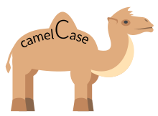
Casing
SentenceCase
Also called PascalCase.
This is the case format used by C# for classes and properties (and classes in Java).
When JSON is deserialized to a C# class, keys are written SentenceCase unless you deliberately set the property name (or serialization configuration) to camelCase.
camelCase
This is the format most typically used in a web-environment and what you will see in JavaScript style guides.
capitalizeEachWordExceptFirst

Slide 6

Casing
snake_case
Routinely found in Python environments.
each_word_is_lowercase
separate_words_with_underscores
This is not a typical JSON case format, but it's introduced in case you are a Python fan

Slide 7
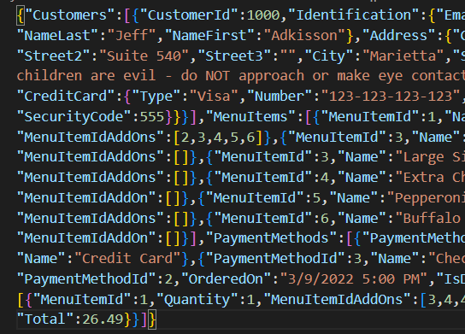
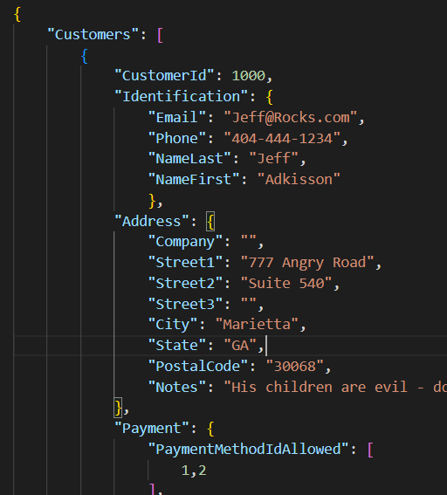
Indentation
JSON can be indented or not. It works the same either way.
Not Indented
Smaller file to transmit to client.
Smaller file, so less storage space consumed.
I recommend not indenting in production environments
Indented
Slightly larger file because of tabs/spaces and line feeds
Easier to read for humans.
I recommend indenting in development environments to aid debugging

Slide 8
Start a JSON Document
The outermost symbols are either:
Array [ ]
let users = [ "Jeff", "Max", "Chloe", "Poe", "Girlie" ];
Object { }
let config = { "caseType": "camel", "maximumPermitted": 1000 }

Slide 9
Arrays can contain objects (and objects can contain arrays)
Object
Array of n Objects
{
"caseType": "camel",
"users" = [
"Jeff", "Max"
]
}
[
{
"caseType": "camel",
"users" = [ "Jeff", "Max" ]
},
{
"caseType": "pascal",
"users" = [ "Chloe", "Girlie" ]
}
]

Slide 10
Permitted Data Types in a JSON document
object
array
string
number
boolean
null

Slide 11
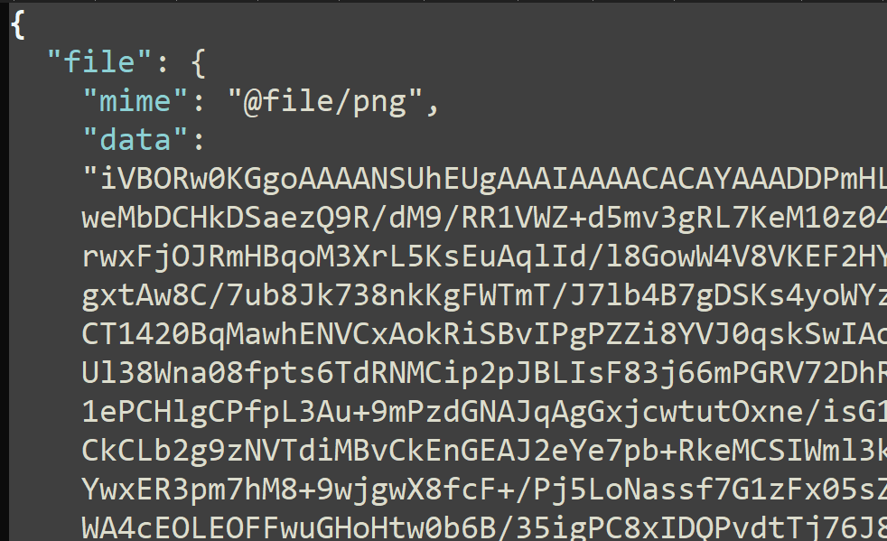

What about binary data such as images?
https://en.wikipedia.org/wiki/Base64
JSON is very flexible. If you want to store data such as files or images, you can convert the binary data into Base64 and store it in the JSON document. For example:
https://base64.guru/converter/encode/file

Slide 12
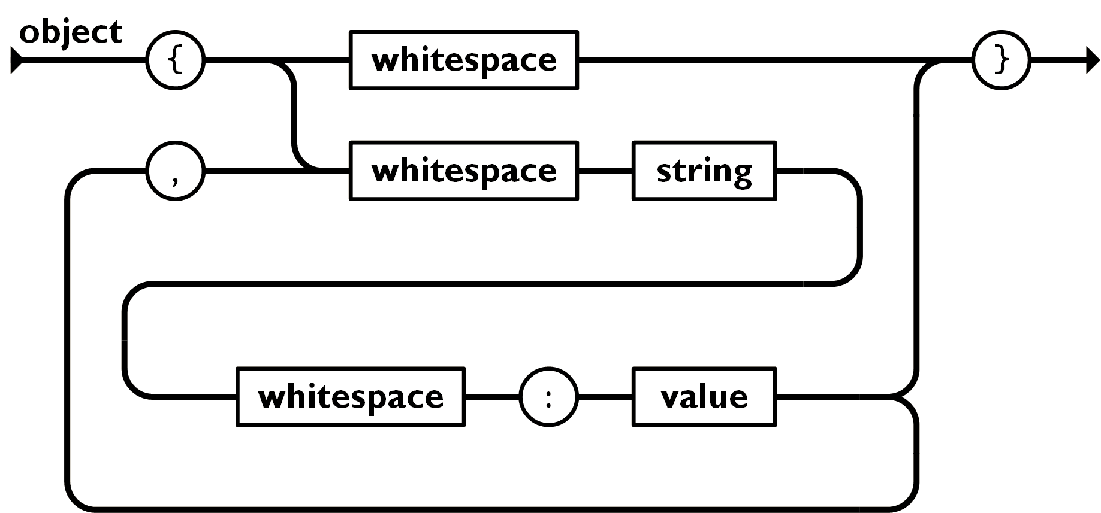
JSON.org
An object is an unordered set of name/value pairs. An object begins with a { left curly brace and ends with } right curly brace. Each name is followed by a colon ( : ) and the name/value pairs are separated by commas ( , ).
https://en.wikipedia.org/wiki/Syntax_diagram

Slide 13
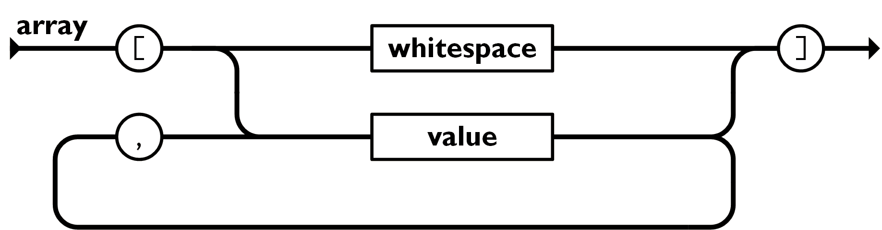
JSON.org: array
An array is an ordered collection of values. An array begins with the [ left bracket and ends with the ] right bracket. Values are separated by commas ( , ).

Slide 14
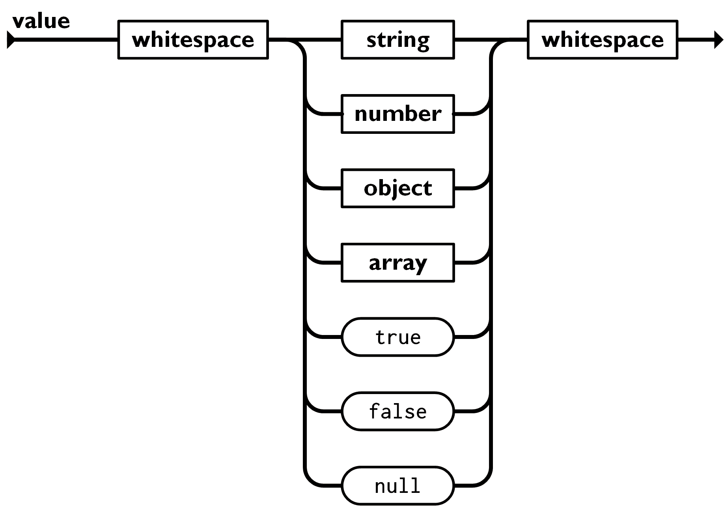
JSON.org: value
A value can be a string in double quotes, or a number, or true or false or null, or an object or an array. These structures can be nested.

Slide 15
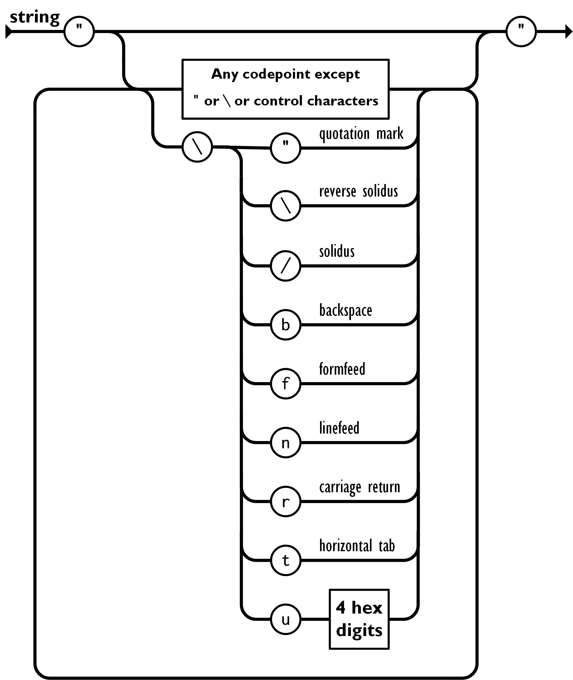
JSON.org: string
A string is a sequence of zero or more Unicode characters, wrapped in double quotes, using backslash escapes. A character is represented as a single character string. A string is very much like a C or Java string.

Slide 16
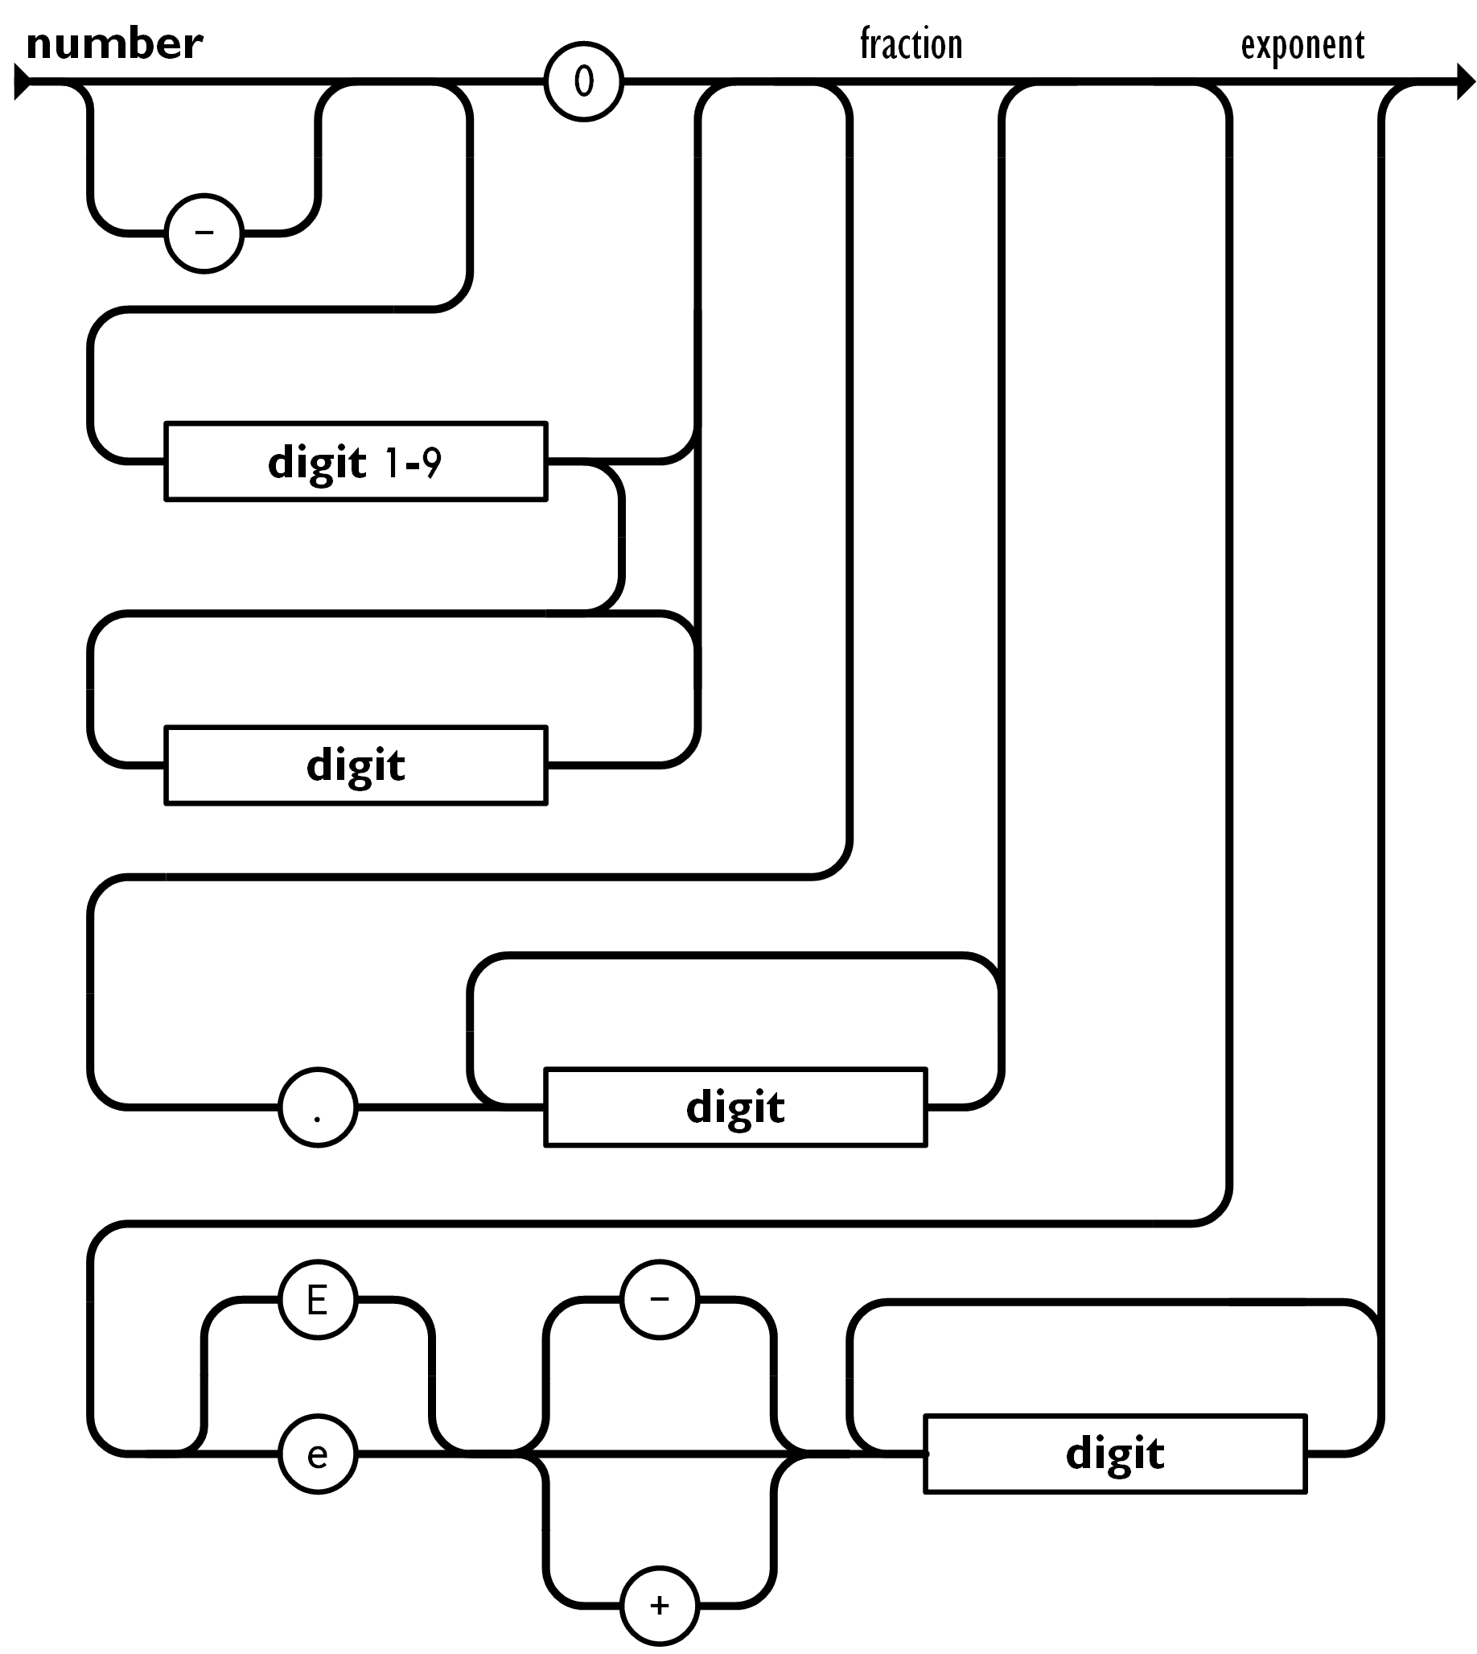
JSON.org: number
A number is very much like a C or Java number, except that the octal and hexadecimal formats are not used.

Slide 17
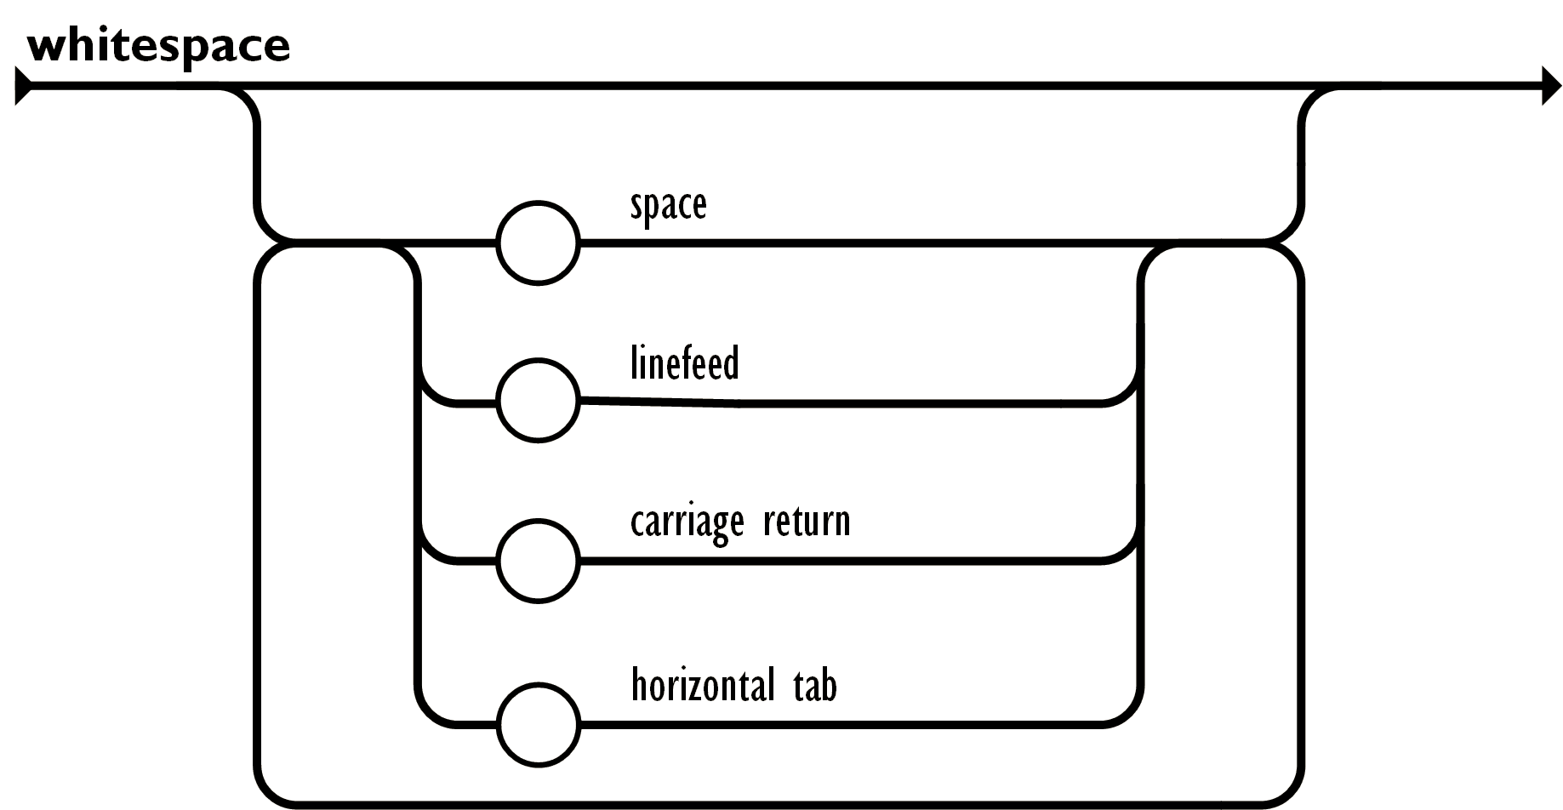
JSON.org: number
Whitespace can be inserted between any pair of tokens. Excepting a few encoding details, that completely describes the language.

Slide 18
Serializing and Deserializing Data
JSON Serialization
Converts an object instance (C#, Java, doesn't matter) into JSON.
JSON Deserialization
Converts JSON into an object instance (C#, Java, doesn't matter)

Slide 19
Dehydrating and Hydrating Alternate Terminology You May Hear
Sometimes people use these terms instead of serialize and deserialize:
Dehydrating = Serializing - Traverse and object and put all of the data into a new form. - This makes more sense if you think of this as pulling all of the important pieces out of an object graph, similar to the way dehydrating food takes out the moisture and leaves the food.
Hydrating = Deserializing - This one makes more sense… - Take an empty object and fill it (hydrate it) with data.

Slide 20
Serializing C# Example: Class to Serialize
public class Configuration {
public string Username { get; set;}
public string Password { get; set; }
public int MaxUsers { get; set; }
}

Slide 21
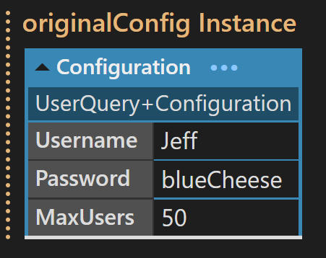
Serializing C# Example: Create Instance
var originalConfig = new Configuration {
Username = "Jeff",
Password = "blueCheese",
MaxUsers = 50
};

Slide 22
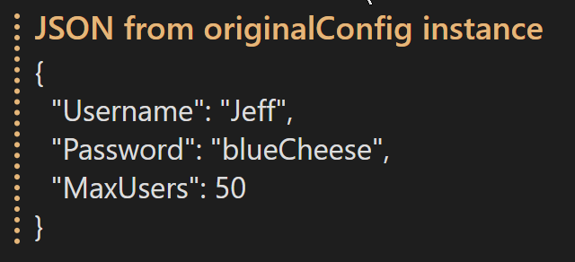
Serializing C# Example: Serialize Instance to JSON
var serializerOptions = new JsonSerializerOptions {
WriteIndented = true, //PropertyNamingPolicy = JsonNamingPolicy.CamelCase
}; //optional, makes json pretty
var configJson = System.Text.Json.JsonSerializer.Serialize(
originalConfig, serializerOptions);

Slide 23
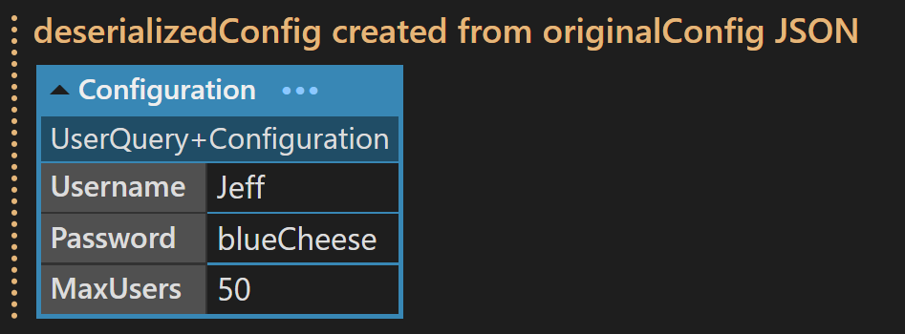
Serializing C# Example: Deserialize JSON to new Instance
var deserializedConfig = System.Text.Json.JsonSerializer.Deserialize<Configuration> (
configJson );

Slide 24
LinqPad Demos
These demos use LinqPad 7. Note that the free version of LinqPad does not allow NuGet packages, so see the conversion slides at the end to run these in VS or Rider. If you like C# or use it professionally, I recommend buying a LinqPad license. Go in with some friends and split the $150 cost of the educational edition which gives you a 200-computer license.
Demo 1 – CSV
Demo 2 – Simple JSON object
Demo 3 – JSON object with an array
Demo 4 – Object with array of complex objects
Demo 5 – Deeply nested object arrays
Demo 6 – CamelCase to/from PascalCase with data lookup
Demo 7 – CamelCase to/from PascalCase via attributes
Demo 8 – Demo 7, plus find all bad tippers using loops and LINQ
Demo 9 - JSON Querying via JMESPath

Slide 25
Case Conversion / Mapping Demos 6 and 7
JSON is a JavaScript standard and JavaScript prefers camelCasing.
Your preferred language may have a different standard.
For example, C# and Java are generally PascalCased for Classes and Properties (C#).
Sometimes you have to tell your serializer that you are writing camelCase. For example, you are sending data from a server to a web browser. Web browsers use JavaScript and JavaScript naming conventions are usually camelCased.
Data returning to your system from the browser will need to map the camelCase back to PascalCase (or whatever) via some mechanism (such as serializer configurations or attributes).

Slide 26
Case Conversion / Mapping Demo 6 - Configuration
{
database: {
userName: "Jeff",
password: "blueCheese",
rights: [
"read", "update"
]
}
}
public class Config {
public Database camelCase { get; set; }
} public class Database { public string UserName { get; set; }
public string Password { get; set; }
public string Rights[] { get; set; }
}
var jsonConfig = new JsonSerializerOptions { PropertyNamingPolicy = JsonNamingPolicy.CamelCase };
var myData = System.Text.Json.JsonSerializer.Serialize(json, jsonConfig);
JSON
C#

Slide 27
Case Conversion / Mapping Demo 7 – Attribute Mapping
{
database: {
userName: "Jeff",
password: "blueCheese",
rights: [
"read", "update"
]
}
}
public class Config {
[JsonPropertyName("database")] public Database my Data { get; set; }
} public class Database { [JsonPropertyName("username")] public string UserName { get; set; }
[JsonPropertyName("password")] public string Password { get; set; }
[JsonPropertyName("rights")] public string Rights[] { get; set; }
}
JSON
C#

Slide 28
Attribute Mapping Attribute mapping useful to map poorly labeled keys to descriptive property names
{
db: {
un: "Jeff",
pw: "blueCheese",
grants: [
"read", "update"
]
}
}
public class Config {
[JsonPropertyName("db")] public Database Database { get; set; }
} public class Database { [JsonPropertyName("un")] public string UserName { get; set; }
[JsonPropertyName("pw")] public string Password { get; set; }
[JsonPropertyName("grants")] public string Rights[] { get; set; }
}
JSON
C#

Slide 29
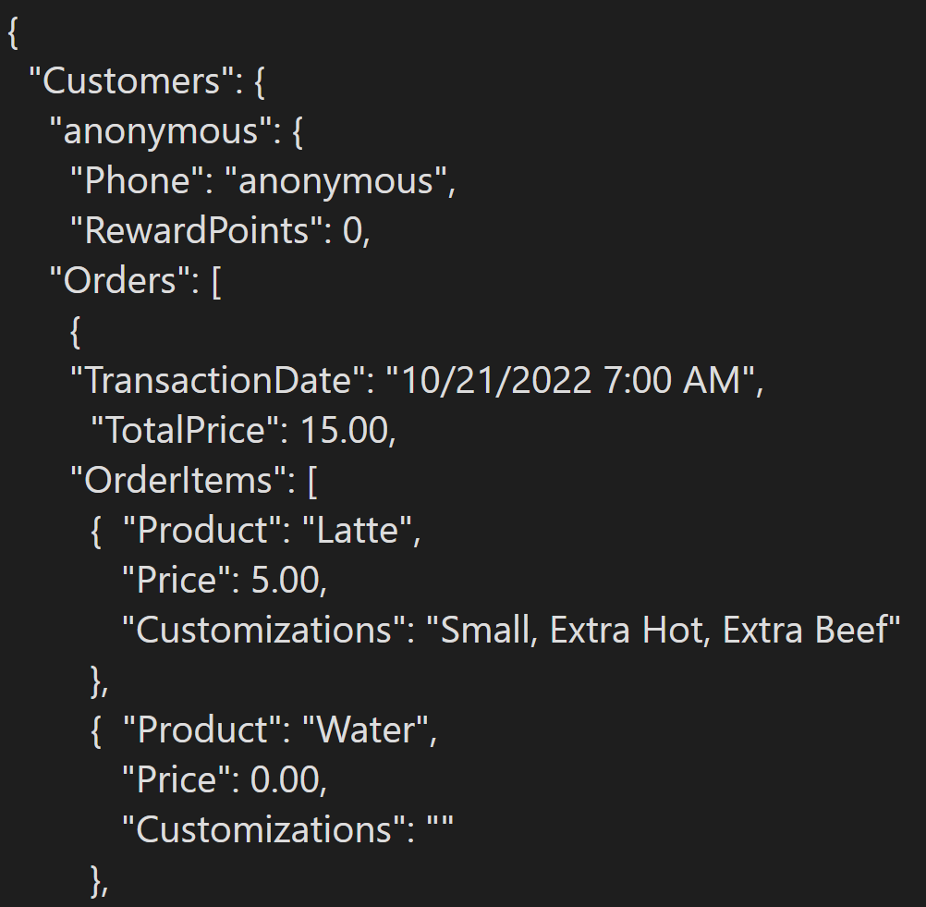
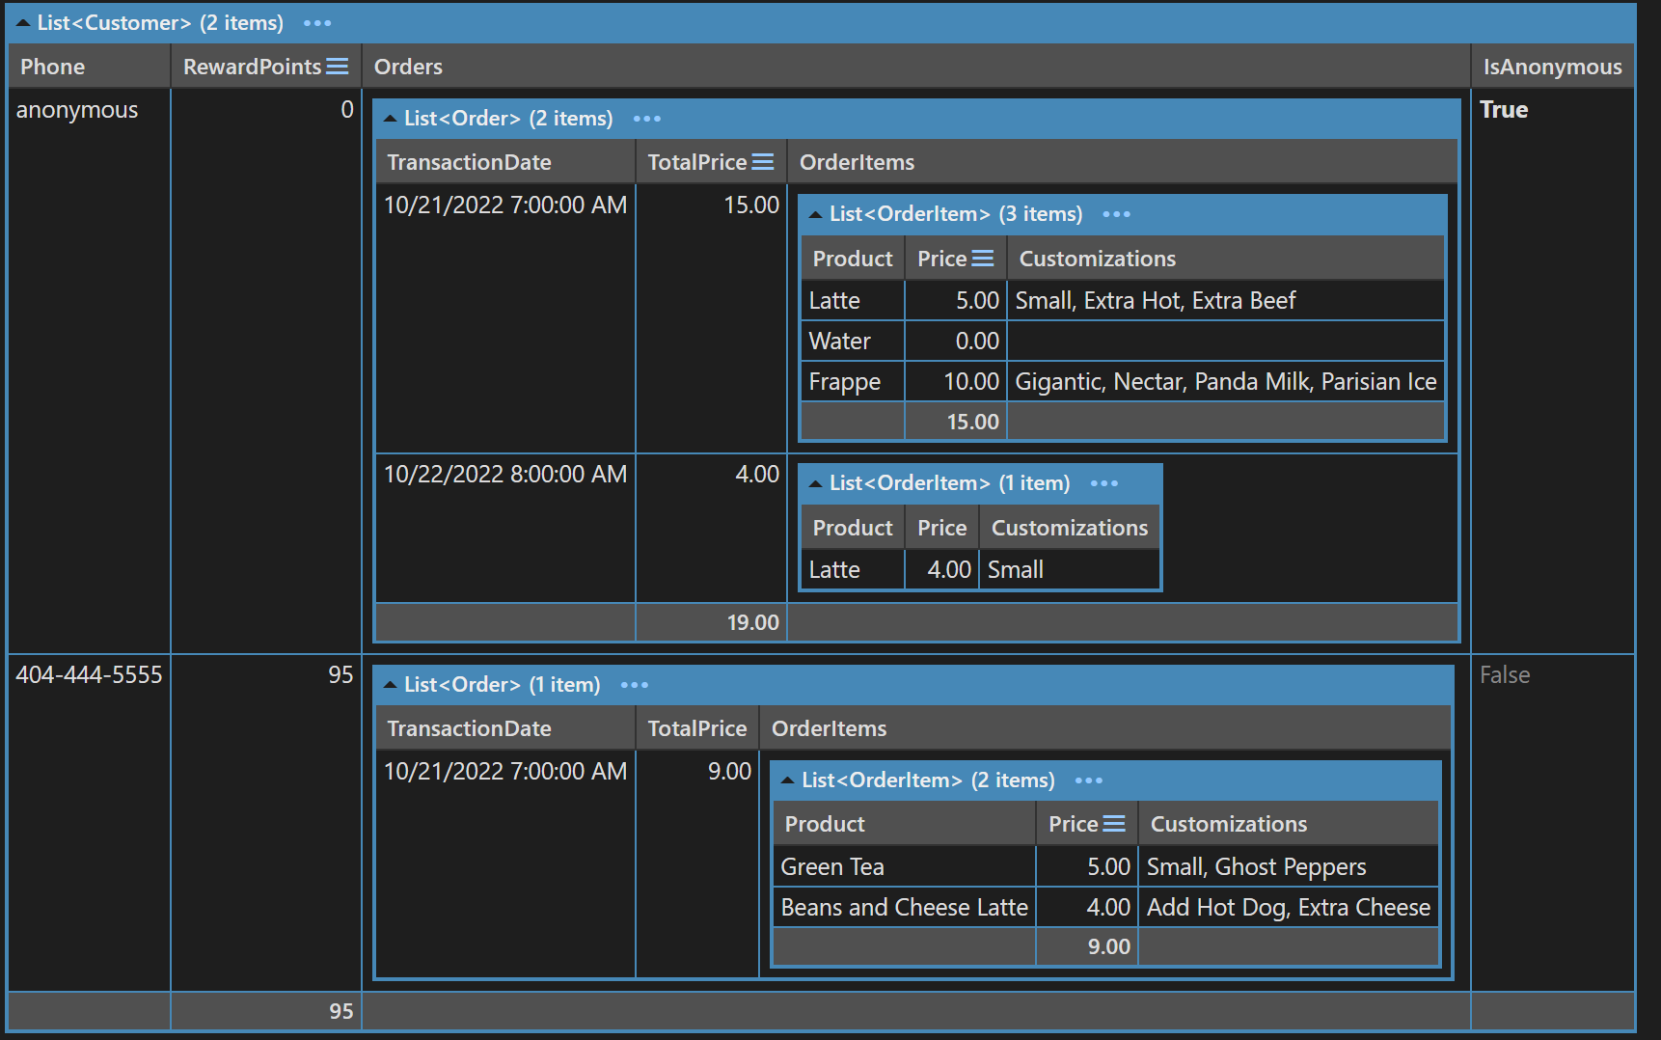
Customer Demo

Slide 30
Convert LinqPad Scripts to C# Project
Create empty project in Rider or Visual Studio.
Open .linq file in a text viewer (Notepad++, etc.).
Add the NuGet references from the Linqpad Query node to your Rider/VS project.
Copy code into a file in Rider/VS.
Add the Namespace values to the top of your Rider/VS file.
Do one of the following:
Convert .Dump() methods into Console.WriteLine calls, or
Add ObjectDumper.NET Nuget package and change .Dump() methods to ObjectDumper.Dump().

Slide 31
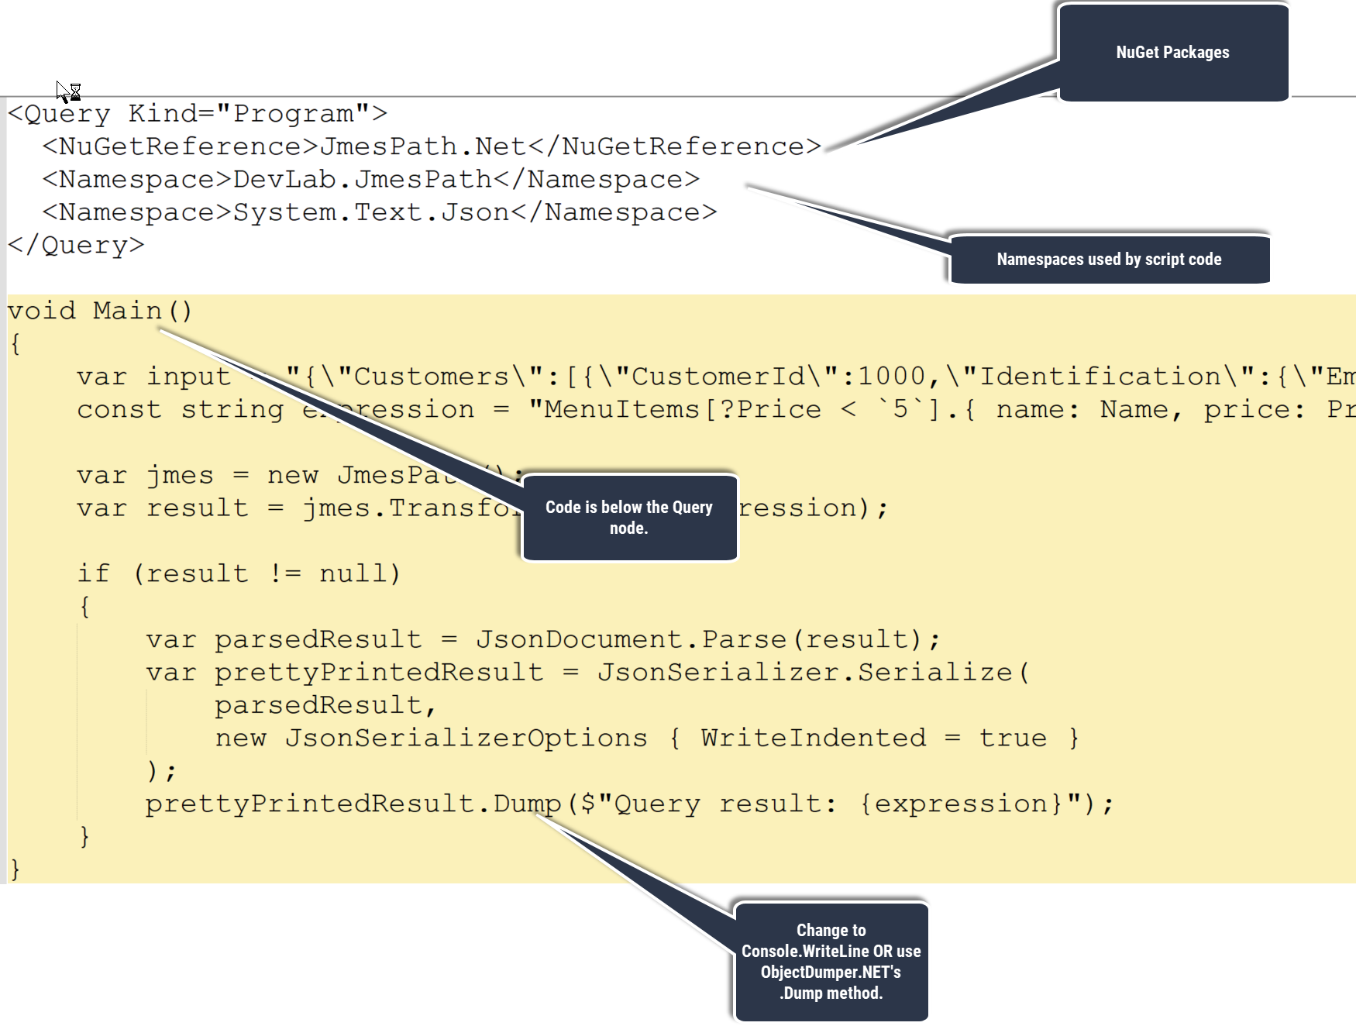
Convert LinqPad Scripts to C# Project

Slide 32
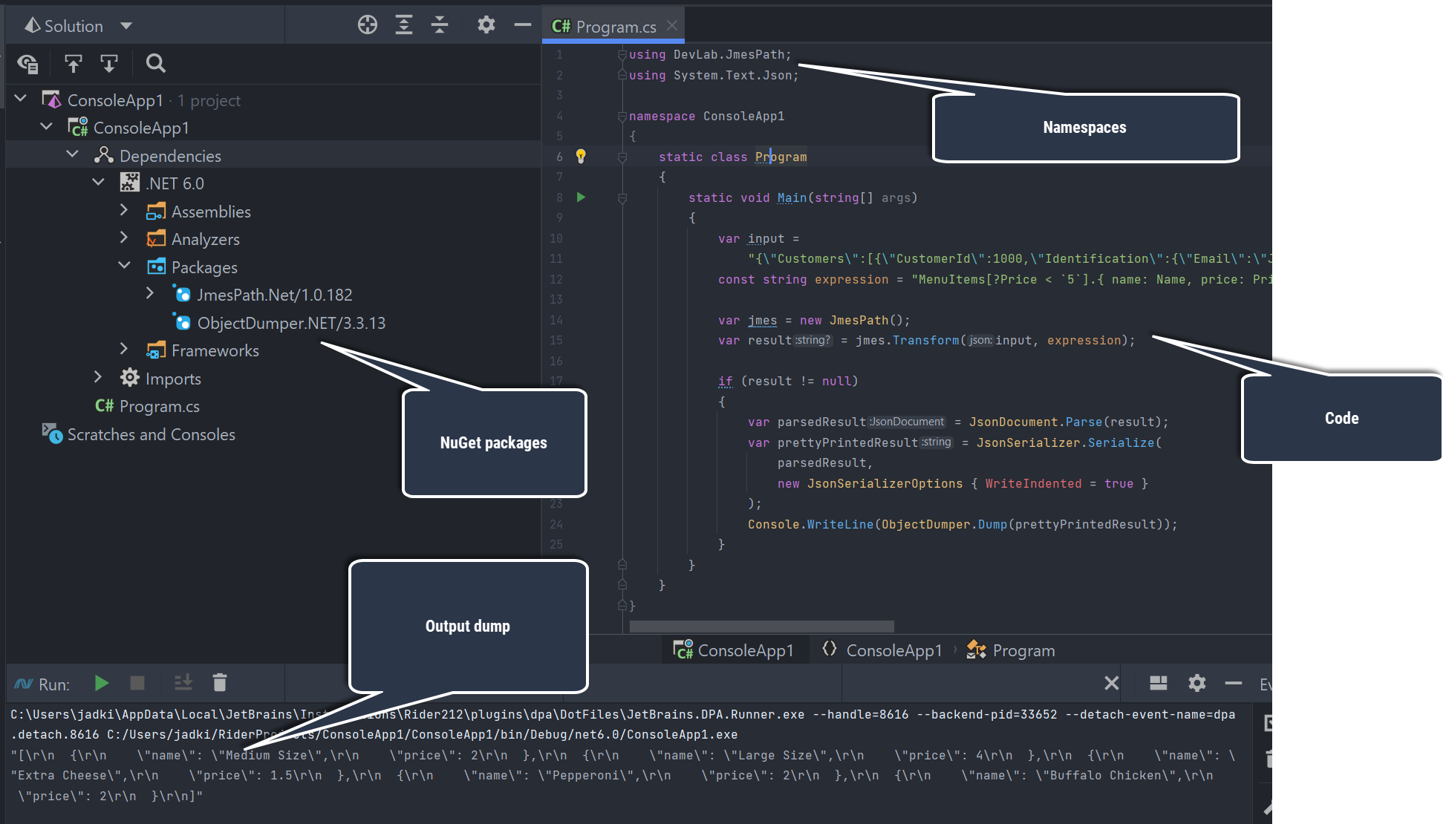
Convert LinqPad Scripts to C# Project

Slide 33
Useful JSON Sites
JSON Pretty Print, Visualizer https://codebeautify.org/jsonviewer
JSON to Java Code Generator https://freecodegenerators.com/json-to-pojo
JSON to C# Code Generator https://json2csharp.com/
JSON Graph Visualizer https://codebeautify.org/visualize-json-data-graph
JMESPath JSON Query/Transform https://jmespath.org/ https://api.gopipeline.io/jmespath-tester

